Slide 1

Toomer ES
Notes:
Good Morning/Afternoon! Today we begin the process of planning our school’s budget for FY21. I know we are all here for the same reason and that is ensuring success for all (enter school name) students. This meeting is to provide an overview of the draft budget and for you to give feedback on the draft budget.

Slide 2
Norms
This is a meeting of the GO Team. Only members of the team may participate in the discussion. Any members of the public present are here to quietly observe.
We will follow the agenda as noticed to the public and stay on task.
We invite and welcome contributions of every member and listen to each other.
We will respect all ideas and assume good intentions.

Slide 3



GO Team Budget Development Process
YOUR SCHOOL STRATEGIC PLAN…
is your roadmap and your role. It is your direction, your priorities, your vision, your present, your future.
Step 1: Data Review
Step 2: Strategic Plan Review
Step 3: Budget Parameters
Step 4: Budget Choices
Notes:
Today I will provide an overview of the budget allocations for FY21. We will begin the work of funding the strategic priorities we agreed upon during our strategic review meeting. (IF YOU HAVE NOT DECIDED ON YOUR PRIORITIES, YOU WILL SAY – WE WILL DECIDE ON OUR PRIORITIES AND THEN DISCUSS ALLOCATING FUNDS TO ADDRESS THOSE PRIORITIES).

Slide 4
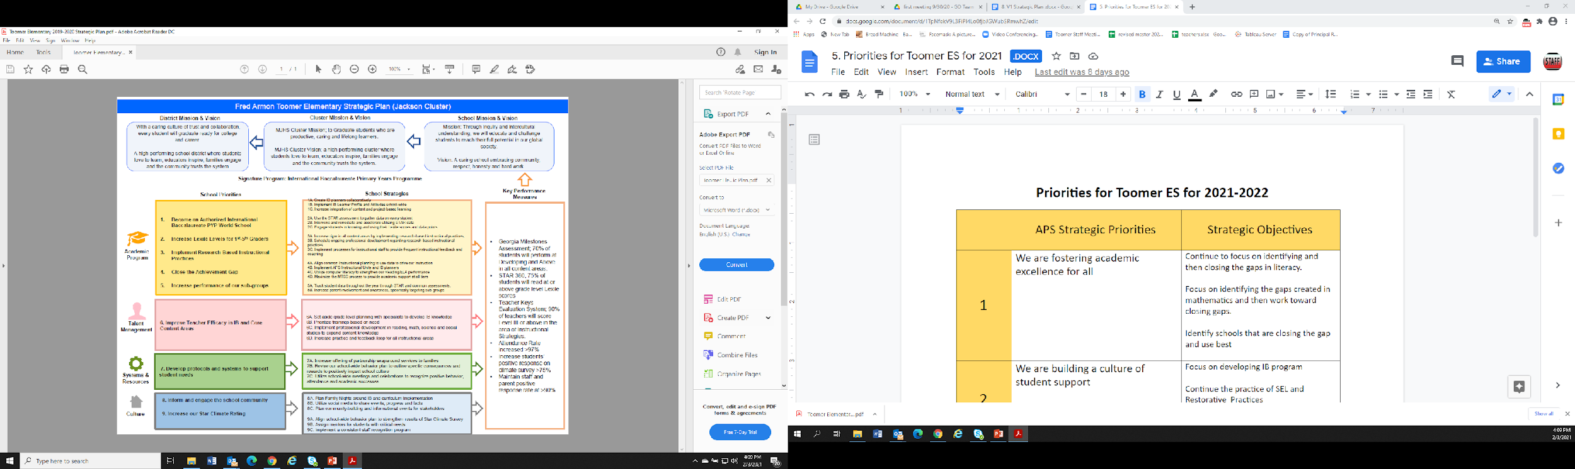

Toomer Strategic Plan
Notes:
You should have a copy of our updated strategic plan (please make copies to be distributed to team).

Slide 5
FY22 Priorities
Priorities for Toomer ES for 2021-2022
 | APS Strategic Priorities | Strategic Objectives
1 | We are fostering academic excellence for all | Continue to focus on identifying and then closing the gaps in literacy. Focus on identifying the gaps created in mathematics and then work toward closing gaps. Identify schools that are closing the gap and use best practices.
2 | We are building a culture of student support | Focus on developing IB program Continue the practice of SEL and Restorative Practices Develop a framework of trauma informed adults
3 | We are creating a system of support for schools | Developing all staff to be trauma informed Develop our response to behavior to be based in trauma informed practices, restorative practices, and through a lens of equity and culturally responsive. Developing teacher leaders in IB and Gifted
Notes:
Discuss priorities and rationale

Slide 6
FY22 Budget Parameters
FY22 School Priorities | Rationale
Continue to focus on identifying and then closing the gaps in literacy. Focus on identifying the gaps created in mathematics and then work toward closing gaps. Identify schools that are closing the gap and use best | Due to the pandemic the students of Toomer have not had as much opportunity for instruction in math and literacy. This is due to many reasons from available of internet access, requiring parents to be active participants in instruction as opposed to active supporters. As we move into 2022 school year we want to identify best practices in other schools so that we may apply them at Toomer.
Focus on developing IB program Continue the practice of SEL and Restorative Practices Develop a framework of trauma informed adults
Notes:
Discuss priorities and rationale. After you have gone over the priorities and rationale – ask GO Team if this represents what was agreed upon.
Are there any priorities I left off?
Are there any questions or concerns?
The next time we meet, I will show you how I have allocated resources to support our strategic priorities.

Slide 7
FY22 Budget Parameters
FY22 School Priorities | Rationale
Focus on developing IB program Continue the practice of SEL and Restorative Practices Develop a framework of trauma informed adults | All four of these practices fit into our cluster and district plans. They also support our vision of being a community of inquiry based learners who work through a lens of equity.
Notes:
Discuss priorities and rationale. After you have gone over the priorities and rationale – ask GO Team if this represents what was agreed upon.
Are there any priorities I left off?
Are there any questions or concerns?
The next time we meet, I will show you how I have allocated resources to support our strategic priorities.

Slide 8
FY22 Budget Parameters
FY22 School Priorities | Rationale
Developing all staff to be trauma informed Develop our response to behavior to be based in trauma informed practices, restorative practices, and through a lens of equity and culturally responsive. Developing teacher leaders in IB and Gifted | These are the systems that are required to implement priority 1 and 2.
Notes:
Discuss priorities and rationale. After you have gone over the priorities and rationale – ask GO Team if this represents what was agreed upon.
Are there any priorities I left off?
Are there any questions or concerns?
The next time we meet, I will show you how I have allocated resources to support our strategic priorities.

Slide 9
FY22 Priorities
Priorities for Toomer ES for 2021-2022
Order
 | APS Strategic Priorities | Strategic Objectives
1 | We are fostering academic excellence for all | Continue to focus on identifying and then closing the gaps in literacy. Focus on identifying the gaps created in mathematics and then work toward closing gaps. Identify schools that are closing the gap and use best
2 | We are building a culture of student support | Focus on developing IB program Continue the practice of SEL and Restorative Practices Develop a framework of trauma informed adults
3 | We are creating a system of support for schools | Developing all staff to be trauma informed Develop our response to behavior to be based in trauma informed practices, restorative practices, and through a lens of equity and culturally responsive. Developing teacher leaders in IB and Gifted
Notes:
Discuss priorities and rationale

Slide 10
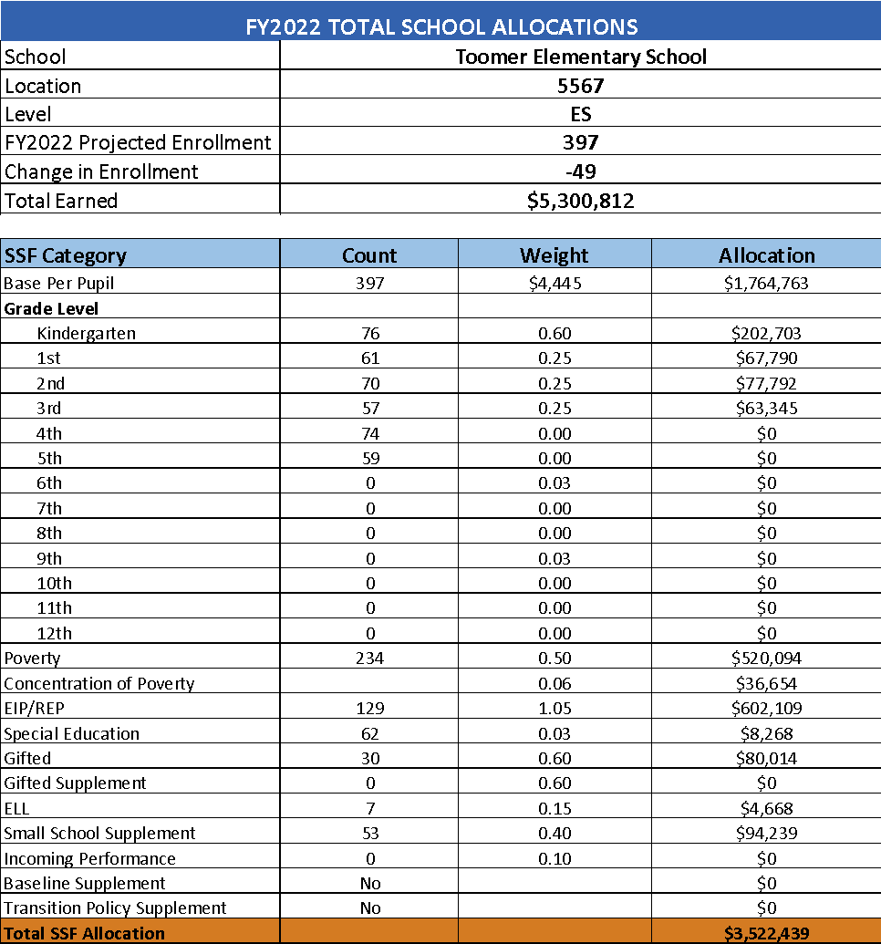
School Allocation
Notes:
Additionally, we received money for signature programming, turnaround, Title I and FTE Allotments.

Slide 11
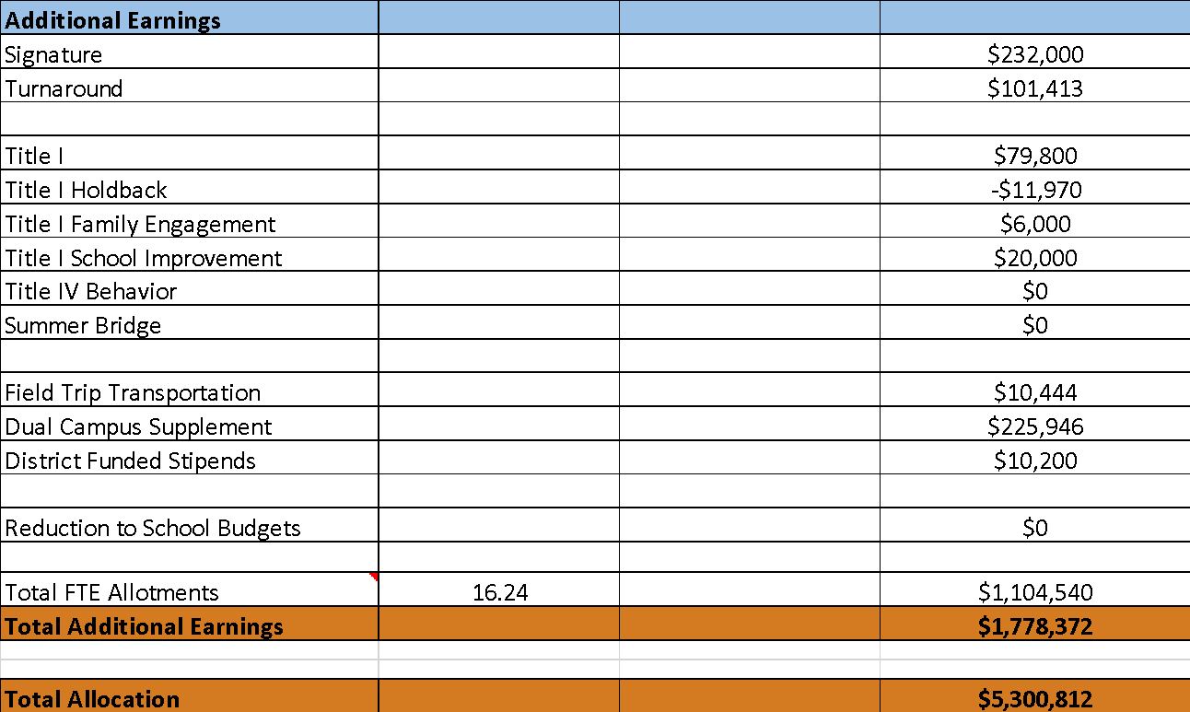
School Allocation
Notes:
Additionally, we received money for signature programming, turnaround, Title I and FTE Allotments.

Slide 12
Discussion of Budget Summary
(Step 4: Budget Choices)
Notes:
Start here on the 24th

Slide 13
Executive Summary
This budget represents an investment plan for our school’s students, employees and the community as a whole.
The budget recommendations are tied directly to the school’s strategic vision and direction.
The proposed budget for the general operations of the school are reflected at $5,000,812
This investment plan for FY22 accommodates a student population that is projected to be 397 students, which is a decrease of 49 students from FY21.
Notes:
Here’s a few highlights for our budget this year – read executive summary

Slide 14
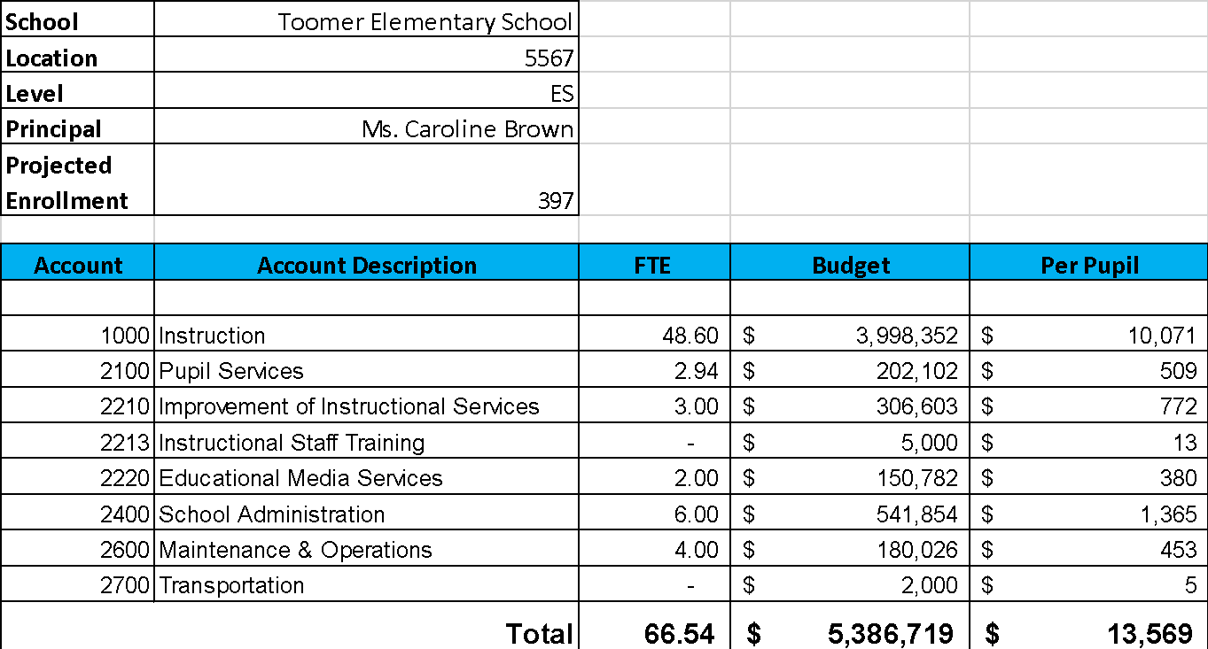
Budget by Function (Required)
Notes:
I am passing out the definitions for these funding categories. You will see what makes up each category. Although the total amount will not change, allocation per function may depending on our conversations and school needs.

Slide 15
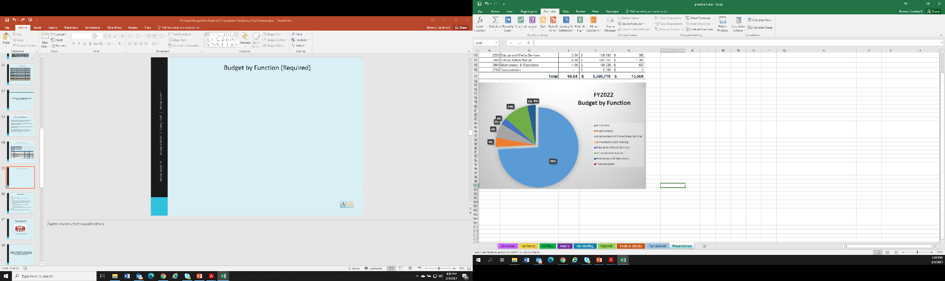
Budget by Function (Required)
Notes:
Explain the pie chart and allocations

Slide 16
What’s Next?
January:
  GO Team Initial Budget Session (Jan. 21st-31st)
February:
  One-on-one Associate Superintendent discussions
  Cluster Planning Session (positions sharing, cluster alignment, etc.)
  Program Manager discussions and approvals
  GO Team Feedback Session
  HR Staffing Conferences (February 24th - March 2nd)
• March:
  Final GO Team Approval (March 3rd - March 13th)
Notes:
In February, we will meet again to discuss how the school’s budget has been allocated to support the programmatic needs and FY22 key strategic priorities.
If think we need to continue our budget conversations, we will schedule additional meetings. My goal is to make sure your voices are reflected in our school’s budget.
I will also be meeting with my Associate Superintendent, program managers and other key leaders to go over our budget and to make sure the school is meeting the standards of service and appropriately staffing.
During the week of Feb. 24th -March 2nd , HR Staffing Conferences will be held. At this meeting, I will present my plan for staff utilization, resource distribution and plan for staffing implications.
We will need to approve the budget at the ________ meeting.

Slide 17

Questions?
Thank you for your time and attention.
Notes:
IF YOU FEEL YOUR TEAM IS READY TO APPROVE THE DRAFT BUDGET, PLEASE DO SO. PLEASE REMIND THEM THAT YOU MAY NEED TO MEET WITH THEM AGAIN, IF THERE ARE CHANGES FROM YOUR MEETINGS WITH DISTRICT LEADERSHIP. LET THEM KNOW YOU WILL KEEP THEM INFORMED!!

Slide 18
Slides to Complete After Initial Meeting and Before You Meet with Associate Supt. And Program Managers

Slide 19
Focus Area Descriptors
Strategic Plan Categories | District Descriptions of Categories
Academic Program | Our students will be well-rounded individuals who possess the necessary academic skills and knowledge and are excited about learning.
Talent Management | We will retain an energized and inspired team of employees who are capable of advancing ever-increasing levels of achievement for students of all backgrounds.
Systems & Resources | We will improve efficiency (productivity, cost, etc.) while also making decisions (including resource allocations) that are grounded in a strategic academic direction and data.
Culture | We will build trust with the community, and we will have engaged stakeholders (employees, students, parents, community members, partners, etc.) who are invested in the mission and vision and who support the creation of student-centered learning communities.
Notes:
I have printed the terms on the next two slides for your convenience. I want to just go over them so we will all be on the same page as we move forward in this process. If you have any questions, please don’t hesitate to ask.

Slide 20
Description of Strategy Categories
Budget Parameters – FY22 funding priorities from the school’s 3-5 year strategic plan, ranked by the order of importance
Strategies – Lays out specific objectives for schools improvement
Request – “The Ask”. What needs to be funded in order to support the strategy?

Slide 21
FY22 Budget Parameters
FY22 School Priorities | Rationale
Continue to focus on identifying and then closing the gaps in literacy. | 42% of all students are performing below grade level in literacy and math
Focus on identifying the gaps created in mathematics and then work toward closing gaps. | This continues to be a need for our students, but we need to look closely at maximizing our budget to make this work.
Focus on developing IB program | IB is a cluster priority that focuses on inquiry based teaching and learning
Developing teacher leaders in IB and Gifted | To support inclusion & inquiry based instruction for all students, and promote student agency.
Continue the practice of SEL, and Restorative Practices | Cultivate a community of learners that proactively restores relationships
Develop our response to behavior to be based in culturally responsive and trauma informed practices, restorative practices, and through a lens of equity. | Through building and maintaining relationships, we will cultivate a diverse community that celebrates differences.
Notes:
Review the priorities that the GO Team has developed and the rationale for these priorities

Slide 22
FY22 Strategic Plan Break-out
Priorities | Focus Area | Strategies | Requests | Amount
Continue to focus on identifying and then closing the gaps in literacy. | Fostering academic excellence | BAS testing & small group instruction | Hiring additional paraprofessional for support | 90,000
 |  | Intervention support & small group instruction | Reading Specialist | 90,000
 |  | Coaching support | Reading Coach | 103,000
 |  | extra small group for DSE students | DSE Literacy Support | 90,000
 |  | WELA support | 2 paraprofessionals | 90,000
 |  | WELA support | materials/supplies | 50,000
 |  | Support for virtual learners | Digital curriculum | $56,000
Notes:
For the next few slides, I will show you how I have allocated the budget to support our strategic priorities.
Based on our strategic priorities and funds we received, here is a break-out of the priorities, which focus area it addresses, the strategies that will be implemented, the purchase request, which funding source was used and the amount.

Slide 23
FY22 Strategic Plan Break-out
Priorities | Focus Area | Strategies | Requests | Amount
Focus on identifying the gaps created in mathematics and then work toward closing gaps. | Fostering academic excellence | GloSS testing & small group instruction | Hiring additional paraprofessional for support | 90,000
 |  | Intervention support & small group instruction | Math Specialist | 90,000
 |  | Coaching support | Math Coach | 103,000
Notes:
For the next few slides, I will show you how I have allocated the budget to support our strategic priorities.
Based on our strategic priorities and funds we received, here is a break-out of the priorities, which focus area it addresses, the strategies that will be implemented, the purchase request, which funding source was used and the amount.

Slide 24
FY22 Strategic Plan Break-out
Priorities | Focus Area | Strategies | Requests | Amount
Focus on developing IB program | building a culture of student support | coaching support | IB Coach | 103,00
 |  | train staff | IB training for staff | 20,000
 |  | teacher support in gathering materials | Media Specialist | 103,000
Developing teacher leaders in IB and Gifted | building a culture of student support | support homeroom teachers | Gifted lead teacher | 90,000
 |  | train staff | Gifted training for teachers | 50,000
Continue the practice of SEL, and Restorative Practices | creating a system of support for schools | SEL support, small groups | Full time counselor | 103,000
 |  |  | Restorative justice training
Notes:
For the next few slides, I will show you how I have allocated the budget to support our strategic priorities.
Based on our strategic priorities and funds we received, here is a break-out of the priorities, which focus area it addresses, the strategies that will be implemented, the purchase request, which funding source was used and the amount.

Slide 25
FY22 Strategic Plan Break-out
Priorities | Focus Area | Strategies | Requests | Amount
Develop our response to behavior to be based in culturally responsive and trauma informed practices, restorative practices, and through a lens of equity. | creating a system of support for schools | Trauma informed practices training | Assistant Principal | 117,000
 |  | daily check-in & out procedures for those who need it | non-instructional para | 45,000
 |  | culturally responsive pedagogy | IB training | 20,000
 |  | Homeroom teachers to support small classrooms | 22 teachers | 2.200,000
 |  | CREATE support | CREATE teacher pair | 30,000
 |  | Wraparound family services | school nurse | 60,000
 |  | Wraparound family support | School social worker | 55,000
 |  | management of school/Liaison support for parents | School Business Manager | 117,000
Notes:
For the next few slides, I will show you how I have allocated the budget to support our strategic priorities.
Based on our strategic priorities and funds we received, here is a break-out of the priorities, which focus area it addresses, the strategies that will be implemented, the purchase request, which funding source was used and the amount.

Slide 26
FY 2022: Purpose of Reserve Funds
  To account for the district’s overall revenue uncertainty & help to mitigate potential losses at leveling
  2% of school’s SSF allocation has been budgeted for NonStaffing
  Use of these funds is subject to District Approval
Notes:
The reserve can be impacted at two points in the budget process: 1. During the summer, dependent upon district revenues matching projections and 2. After the 15-day count for enrollment leveling.

Slide 27
Plan for FY22 Reserve
Priorities | Focus Area | Strategies | Requests | Amount
 | Fostering Academic Excellence | Providing relief time for instructional staff to do additional professional development and peer observations | Substitute | 70,000
Notes:
This slides represent the priorities we will fund if we receive additional money from Title I and the Leveling Reserve. When we approve the budget we will approve both so that we will not have to schedule another meeting if the funds are made available.
Before I turn it back over to the Chair for the next slide, I want to thank you for your hard work and support this year. I will keep you informed as we move through the budget process. (Please inform Chair that they will facilitate the discussion for the last slide)

Slide 28
Plan for FY22
Title I Holdback and Family Engagement Funds
Priorities | Focus Area | Strategies | Requests | Amount
 | Academic Excellence | support of virtual students | additionals take home materials | 18,000
Notes:
This slides represent the priorities we will fund if we receive additional money from Title I and the Leveling Reserve. When we approve the budget we will approve both so that we will not have to schedule another meeting if the funds are made available.
Before I turn it back over to the Chair for the next slide, I want to thank you for your hard work and support this year. I will keep you informed as we move through the budget process. (Please inform Chair that they will facilitate the discussion for the last slide)

Slide 29
Questions to Consider
Are our school’s priorities (from your strategic plan) reflected in this budget?
  Are new positions and/or resources included in the budget to address our major priorities?
  Do we know (as a team) the plan to support implementation of these priorities beyond the budget (ex. What strategies will be implemented)?
  What tradeoffs are being made in order to support these priorities?
2. How are district and cluster priorities reflected in our budget?
  Cluster priorities- what staff, materials, etc. are dedicated to supporting our cluster’s priorities?
  Signature programs- what staff, materials, etc. are dedicated to supporting our signature program?
  Are there positions our school will share with another school, i.e. nurse, counselor?
Notes:
CHAIR - Our final task for today! Here are questions that we need to consider to ensure we have a good working draft budget. Let’s walk through them together.

Slide 30
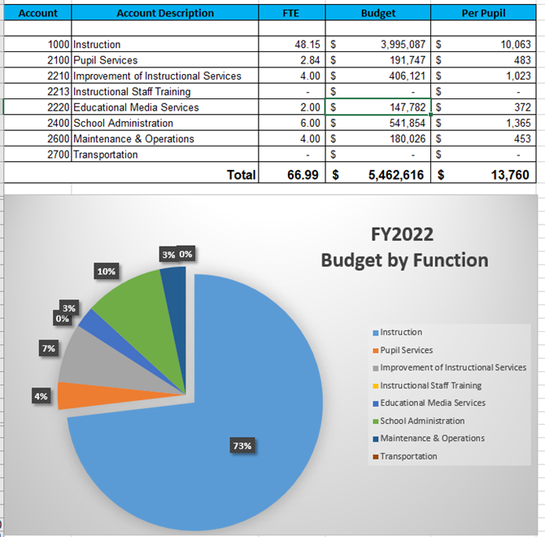
Budget Adjustments
About $75,000 additional dollars than what is posted earlier.

